Slide 1

Sprocket Central Pty Ltd
Data analytics approach
Nwachi Joshua

Slide 2
Agenda
Introduction
Data Exploration
Model Development
Interpretation

Slide 3
Introduction
Identify and Recommend Top 1000 Customer to Target from Datasets
Outline of Problem
Sporocket Central is a company that specializes in high-quality bikes and cycling accessories
Their marketing team is looking to boost business sales by analyzing provided datasets.
Using the three datasets provided the aim is to analyze and recommend 1000 customers that Sproket Central should target
Contents of Data Analysis
“New” and “Old” Customer Distributions
Bike related Purchases over the last three years by gender
Job industry distributions
Wealth segmentation by age category
Number of cars owned and not owned by state
RFM analysis and customer classification

Slide 4
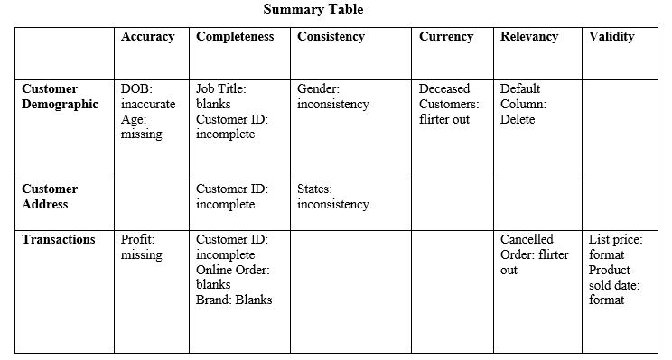
Data Exploration
Data Quality Assessment and “Clean Up”
Key Issues for Data Quality Assessment
Accuracy: Correct Values
Completeness: Data Fields with Values
Consistency: Values Free from Contradiction
Currency: Values up to Date
Relevancy: Data items with Value Meta-data
Validity: Data Containing Allowable Values
Uniqueness: Records that are duplicated
Place any supporting images, graphs, data or extra text here.

Slide 5
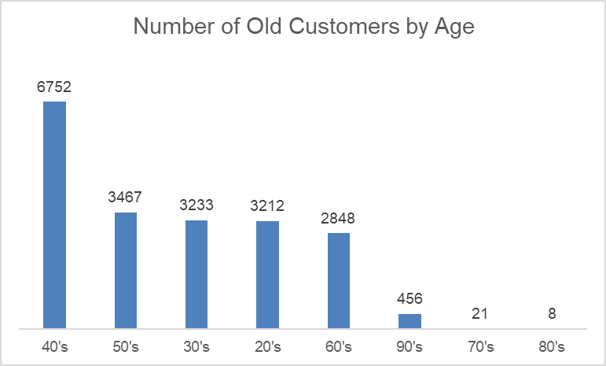
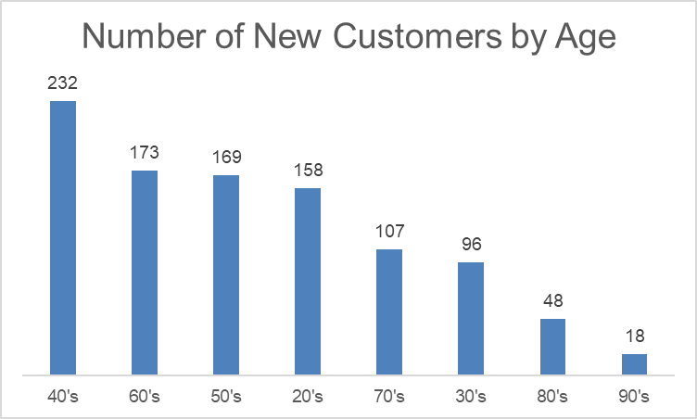
Data Exploration
“New” and “Old” Customer Age Distributions
Key Issues for Data Quality Assessment
Most customers are aged between 40-49 in both “New” and “Old” customers
The lowest age groups are between 70-89 for “Old” customers. In “New” customers it is 90+.
The “New” customer list suggests that age groups 40-69 are most populated.
The “Old” customer list suggests 30-59.

Slide 6
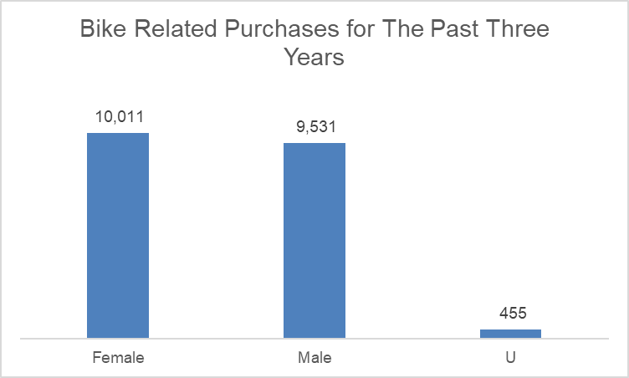
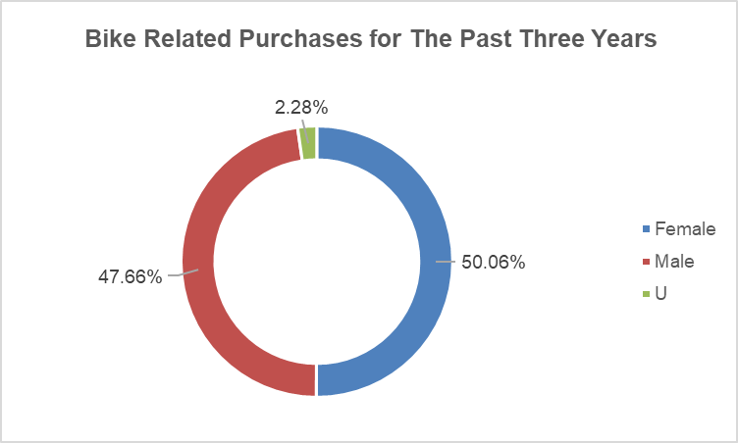
Data Exploration
Bike related purchases over 3 years by gender
Over the last three years about 50% of bike related purchases were made by females to 48% of purchases made by males. Approximately 2% were made by unknown gender.
Numerically, females purchases 480 more than males.
Females make up majority of bike related sales

Slide 7
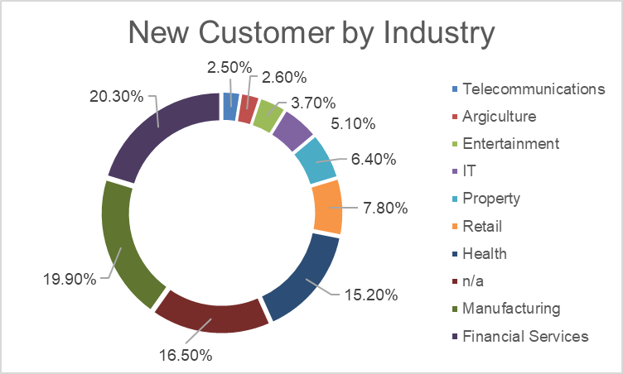
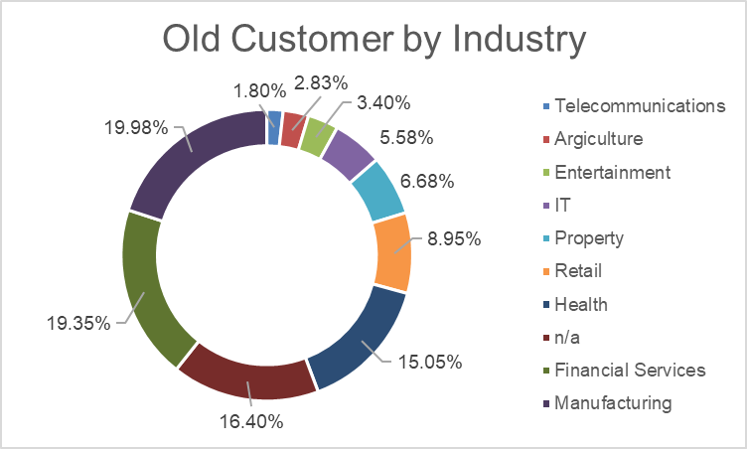
Data Exploration
Job Industry Distribution
20.3% of “New” Customers are in Financial services and 19.90% are in Manufacturing.
The smallest number of customers are in Agriculture and Telecommunications at 2.6% and 2.5%.
Similar pattern in “Old” customer list, at 2.83% and 1.8% respectively.

Slide 8
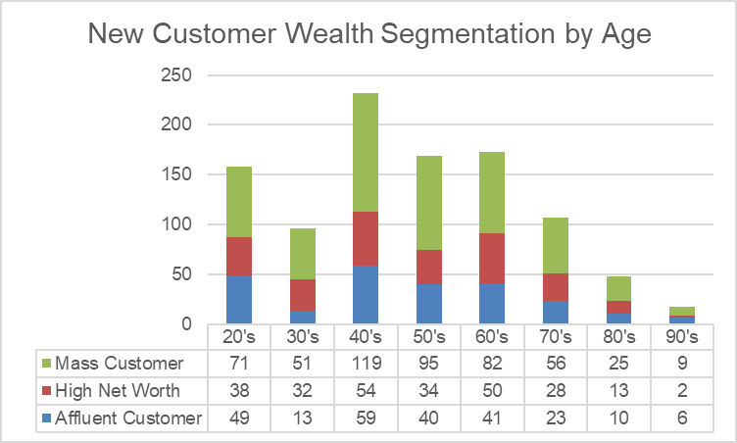
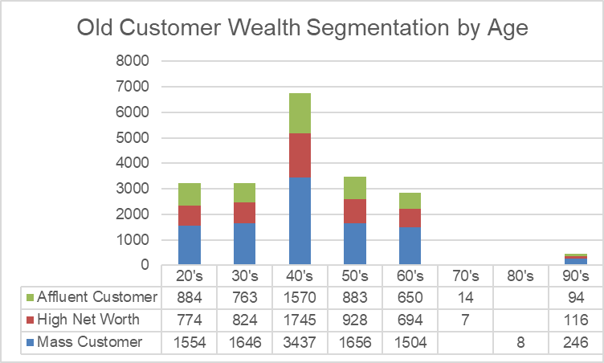
Data Exploration
Wealth Segmentation by age Category
In all age categories, the largest number of customers are classified as “Mass Customer”
The next category is the “High Net Worth” customers.
The “Affluent Customer” can outperform the “High Net Worth” in the 40-49 age group.

Slide 9
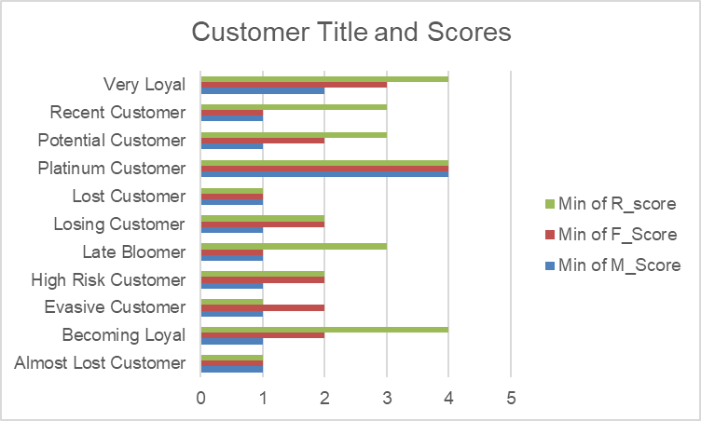
Model Development
RFM Analysis and Customer Classification
RFM analysis is used to determine which customers a business should target to increase its revenue and value,
The RFM( Recency, Frequency, and Monetary) model shows customers that have displayed high levels of engagement with the business in the three categories mentioned.

Slide 10
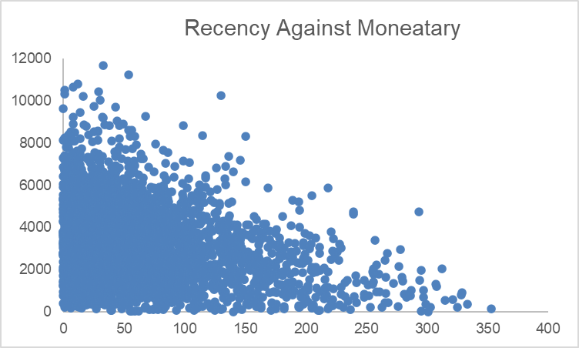
Model Development
Scatter-Plot based off RFM Analysis
The chart shows that customers who purchased more recently have generated more revenue, than customer who visited a while ago.
Customers from (50-100 days) also show to generate a moderate amount of revenue.
Those who visited more than 200 days ago generate low revenue

Slide 11
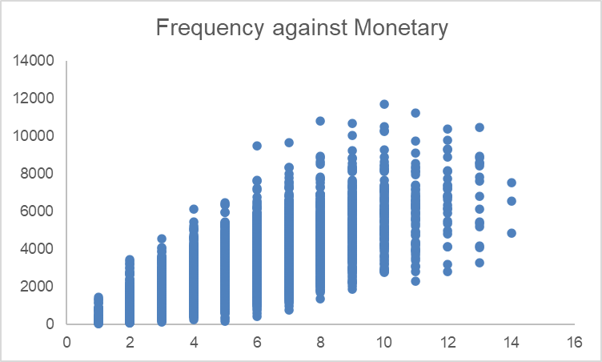
Model Development
Scatter-Plot based off RFM Analysis
Customer classified as “Platinum Customer“, Very Loyal”, and “Becoming Loyal” visit frequently, which correlated with increased revenue to the business.
Naturally, there is a positive relationship between frequency and monetary gain for the business

Slide 12
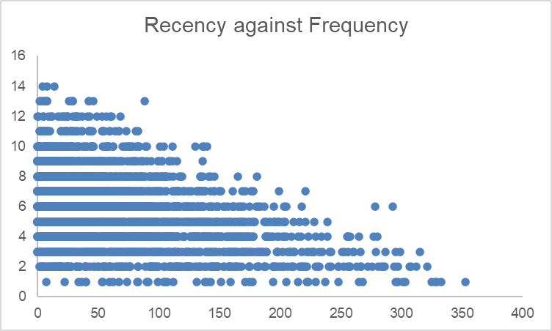
Model Development
Scatter-Plot based off RFM Analysis
Very low frequency of 0-2 correlated with high recency values. i.e More than 250 days ago.
Customers that visited more recently (0-50 days) have higher chance of visiting more frequently (6+).
Higher frequency has a negative relationship with recency values. Such that very recent customers are also frequent customers.

Slide 13
Model Development
Customer Title Definition list with RFM values assigned
Rank | Customer Title | Description | RFM VALUE
1 | Platinum Customer | Most recent buy, buys often, most spent | 444
2 | Very Loyal | Most recent, buys often, spends large amount of money | 433
3 | Becoming Loyal | Relatively recent, bought more than once, spends large amount of money | 421
4 | Recent Customer | Bought recently, not very often, average money spent | 344
5 | Potential Customer | Bought recently, never bought before, spent small amount | 323
6 | Late bloomer | No purchases recently, but RFM value is larger than average | 311
7 | Losing Customer | Purchases was a while ago, below average RFM value | 224
8 | High Risk Customer | Purchase was long time ago, frequency is quite high, amount spent is high | 212
9 | Almost Lost Customer | Almost Lost Customer Very low recency, low frequency, but high amount spent | 124
10 | Evasive Customer | Very low recency, Very low frequency, small amount spent | 112
11 | Lost Customer | Very Low RFM | 111

Slide 14
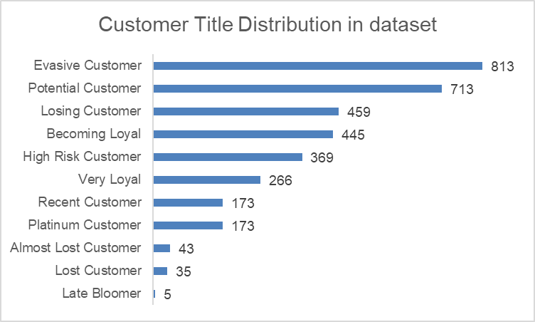
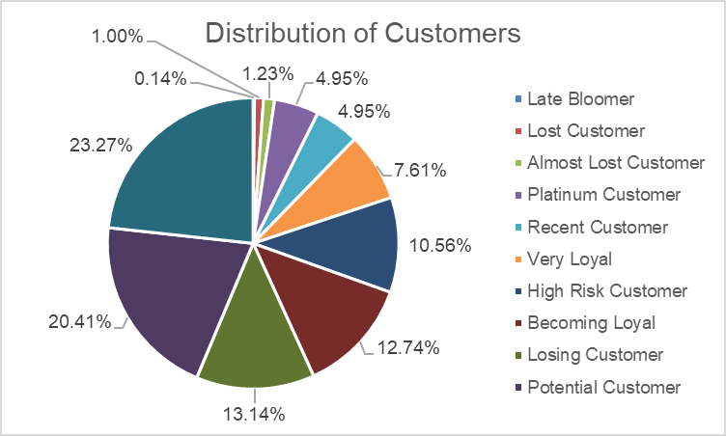
Model Development
Customer Title Distributions in Dataset

Slide 15
Interpretation
Summary Table of the Top 1000 Customers to Target.
Rank | Customer Title | Description | Number of Customers | Cumulative | Customer Selection
1 | Platinum Customer | Most recent buy, buys often, most spent | 173 | 173 | 173
2 | Very Loyal | Most recent, buys often, spends large amount of money | 266 | 439 | 266
3 | Becoming Loyal | Relatively recent, bought more than once, spends large amount of money | 445 | 884 | 445
4 | Recent Customer | Bought recently, not very often, average money spent | 173 | 1057 | 116
5 | Potential Customer | Bought recently, never bought before, spent small amount | 713 | 1770 | 0
6 | Late bloomer | No purchases recently, but RM value is larger than average | 5 | 1775 | 0
7 | Losing Customer | Purchases was a while ago, below average FM value | 459 | 2234 | 0
8 | High Risk Customer | Purchase was long time ago, frequency is quite high, amount spent is high | 369 | 2603 | 0
9 | Almost Lost Customer | Almost Lost Customer Very low recency, low frequency, but high amount spent | 43 | 2646 | 0
10 | Evasive Customer | Very low recency, Very low frequency, small amount spent | 813 | 3459 | 0
11 | Lost Customer | Very Low RFM | 35 | 3494 | 0

Slide 16
Interpretation
Customer Target and Methodology.
Rank | Customer Title | Description | Number of Customers | Cumulative | Customer Selection
1 | Platinum Customer | Most recent buy, buys often, most spent | 173 | 173 | 173
2 | Very Loyal | Most recent, buys often, spends large amount of money | 266 | 439 | 266
3 | Becoming Loyal | Relatively recent, bought more than once, spends large amount of money | 445 | 884 | 445
4 | Recent Customer | Bought recently, not very often, average money spent | 173 | 1057 | 116
Filter through the top 1000 customers by assigning the conditions discussed in the table above.
The 1000 customers discovered would have bought recently, they have bought very frequently in the past and tend to spend more than other customers.

Slide 17
Appendix

